Slide 1
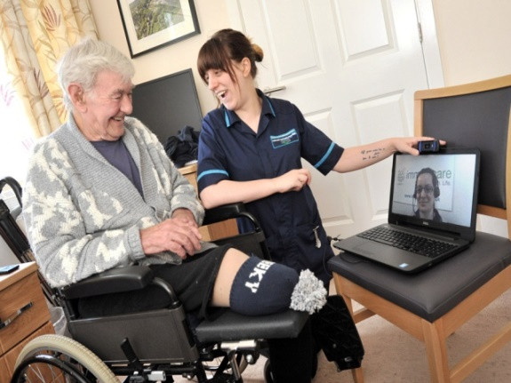

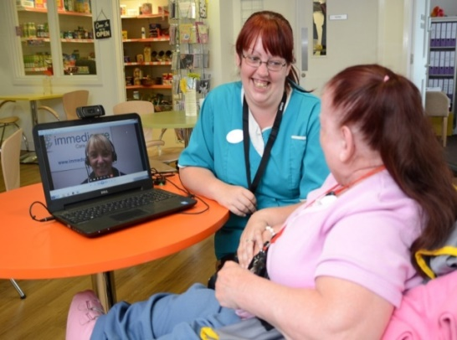
Airedale and Partners Care Home Vanguard
Telemedicine Installation Update
May 2016

Slide 2
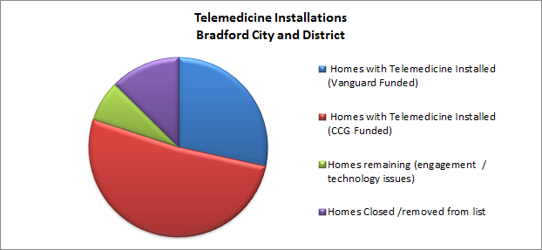
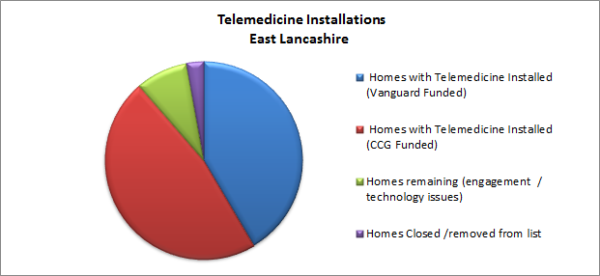
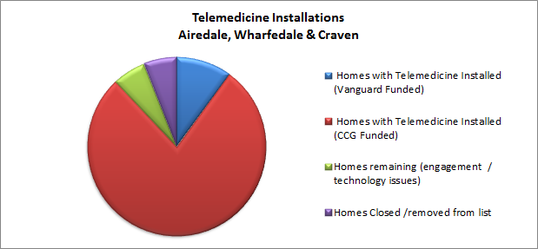
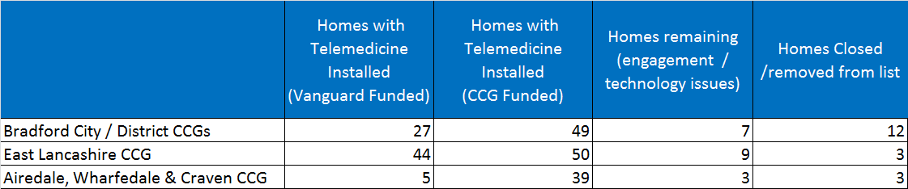
Notes:
By
- promoting choice and control
- maximising independence for the individual
we will look beyond residents’ dependencies to help them enhance their health and well-being capability,
- supporting them to improve their longer term health ambition and ultimately change their care utilisation…
.This enhanced health model will be enabled through technology

